Slide 1
FHIR-Based and Streaming-Enabled
Next-Generation Intelligent
Healthcare Data Repository
- Enabling Big Data Based AI and
Streaming Analytics in Healthcare
www.fastrivertech.com

Slide 2
Next-Generation Intelligent
Next-Generation Intelligent
Healthcare Data Repository
FHIR-Based
Real-Time Streaming-Enabled
Native Big Data
Public Analytics APIs Enabling Deep Learning and AI-Based Real-time Streaming Analytics
FHIR Typed Relational Tables on HDFS
Raw FHIR/HL7 on Data Lake/HDFS
Schema on Write and Read
FHIR MPI

Slide 3
Next-Generation Intelligent
Next-Generation Intelligent
Healthcare Data Repository
FHIR
BIG DATA
STREAM
Healthcare
Data Lake
Healthcare
Data Repository
FHIR
RDBMS
Intelligent Healthcare Analytics API (Python/R/MI/Streaming/SQL/)

Slide 4
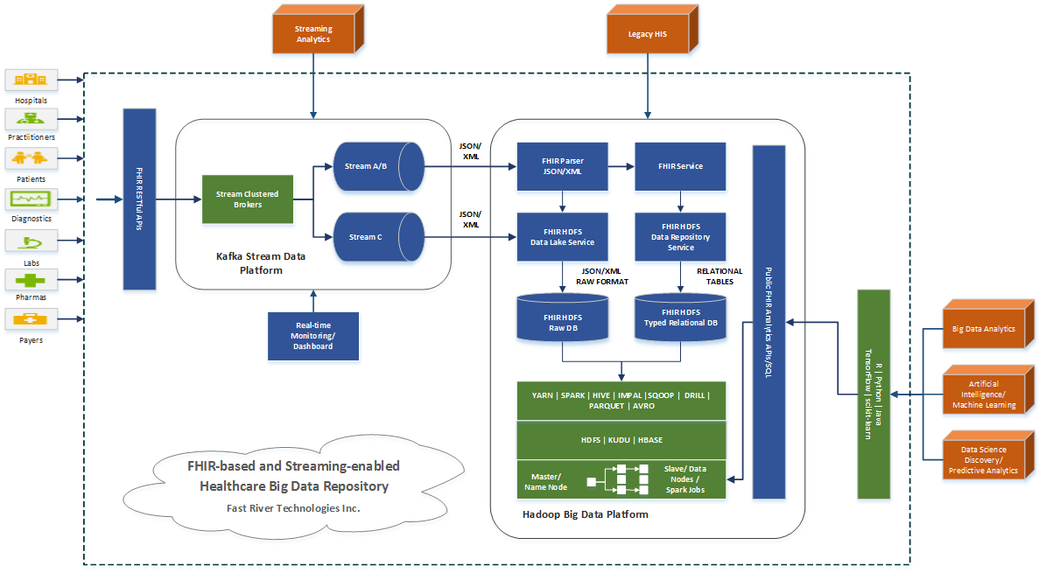
Next-Generation Intelligent
Highlighted Architecture

Slide 5
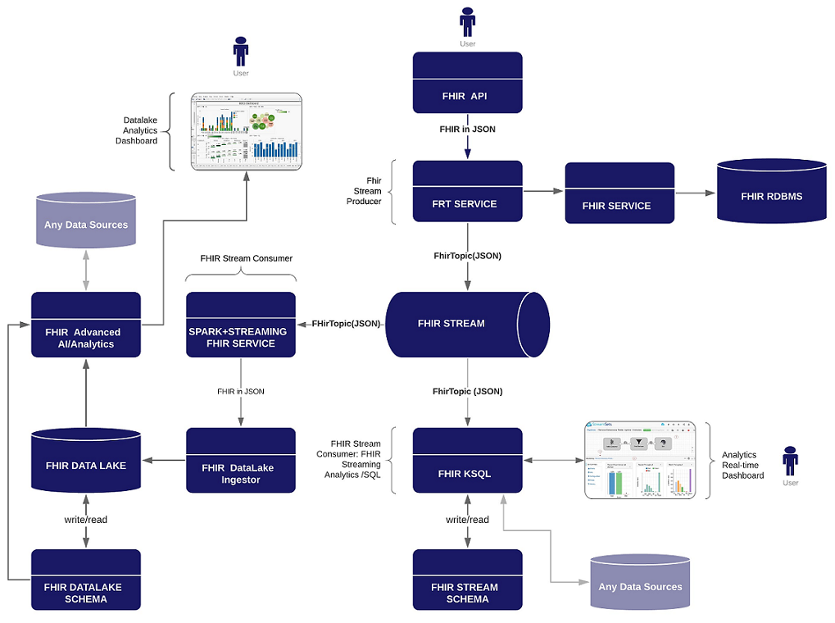
Next-GenerationIntelligent
FHIR-Based Streaming-Enabled HDR + DL

Slide 6
Core Technologies
Policy-Based Global Transaction Management
FHIR Schema on HDFS
Extensible FHIR RDBMS Tables
FHIR/HL7 Schema on Read on HDFS
FHIR/HL7 Schema on Read on Stream

Slide 7
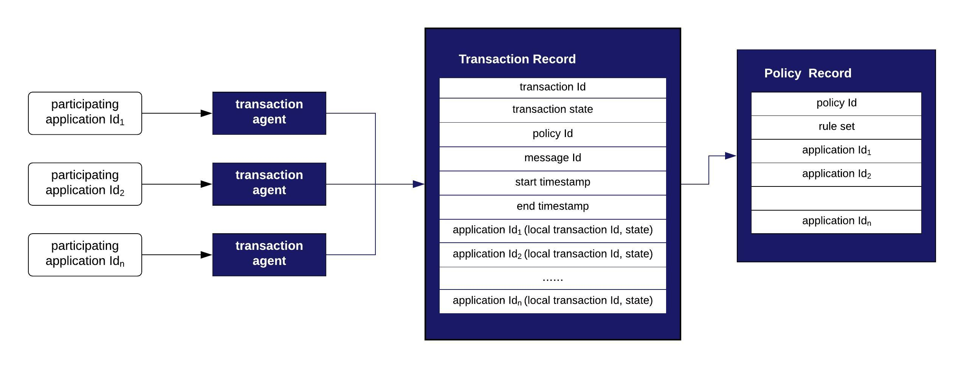
Policy-Based
Global Distributed Transaction Management

Slide 8
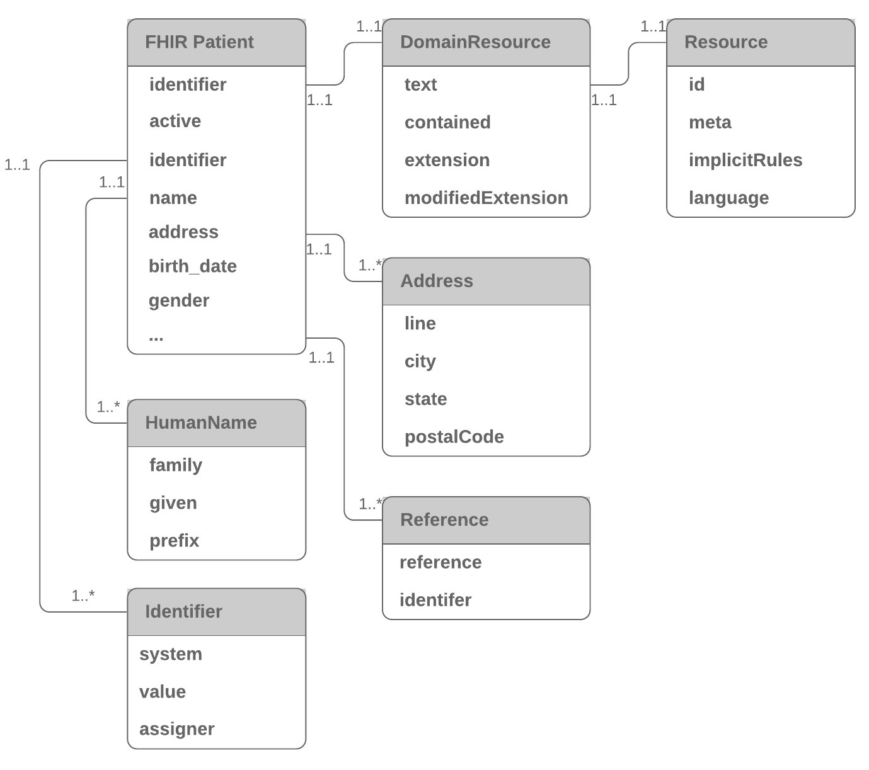
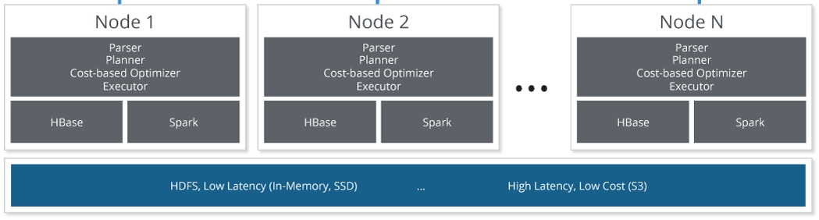
FHIR RDBMS on HDFS

Slide 9
FHIR/HL7 Read Schema on HDFS
Schema
Registry
send schema
read schema
Producer Application(s)
Consumer Application(s)
FHIR/HL7 Stream
HDFS
write FHIR/HL7 raw messages
read FHIR/HL7 messages

Slide 10
FHIR/HL7 Data Lake Read Schema
Spark SQL/ML/Java/Scala/Python
public class Patient {
public static StructType schema() {
StructType schema = new StructType(new StructField[] {
new StructField("resourceType", DataTypes.StringType, false, Metadata.empty()),
new StructField("gender", DataTypes.StringType, false, Metadata.empty()),
new StructField("birthDate", DataTypes.StringType, false, Metadata.empty()),
new StructField("maritalStatus", PatientCodeableConcept.schema(), false, Metadata.empty()),
new StructField("name", new ArrayType(PatientHumanName.schema(), false), false, Metadata.empty()),
new StructField("address", new ArrayType(PatientAddress.schema(), false), false, Metadata.empty()),
new StructField("generalPractitioner", new ArrayType(PatientReference.schema(), false), false, Metadata.empty()),
new StructField("managingOrganization", PatientReference.schema(), false, Metadata.empty())
});
return schema;
}
}

Slide 11
FHIR/HL7 Read Schema on Stream
Schema
Registry
send schema
read schema
Producer Application(s)
Consumer Application(s)
FHIR/HL7 Stream
send FHIR/HL7 messages in Avro
send FHIR/HL7 messages in Avro

Slide 12
FHIR/HL7 Stream Read Schema
Kafka/KSQL
CREATE STREAM FHIR_PATIENT_JSON_STREAM (
resourceType VARCHAR,
gender VARCHAR,
birthDate VARCHAR,
maritalStatus STRUCT<coding ARRAY<STRUCT<system VARCHAR, code VARCHAR>>>,
name ARRAY<STRUCT<family VARCHAR, given ARRAY<VARCHAR>>>,
address ARRAY<STRUCT<city VARCHAR, state VARCHAR>>,
generalPractitioner ARRAY<STRUCT<id VARCHAR>>,
managingOrganization STRUCT<id VARCHAR>)
WITH (KAFKA_TOPIC='FhirTopic',VALUE_FORMAT='JSON');

Slide 13
Thank You

